Slide 1
Traffic Simulation Models
Part 1: from macro to micro
Wilco Burghout

Slide 2
Contents
Traffic Simulation Model classes
MEZZO: Mesoscopic model
Hybrid meso-micro model
Application: Stockholm-Londonviadukten

Slide 3
Traffic model classification
Static
  Models average steady-state traffic situation (EMME/2)
Dynamic
  Models changes over time of the traffic situation
Static
Dynamic
7:00
10:00
15:00
18:00

Slide 4
Traffic model classification (2)
Traffic simulation models are dynamic, follow the changes over time in traffic states
Different levels of detail in simulation models:
  Macroscopic:
    Like water flowing through a pipe
  Mesoscopic
    Individual vehicles with aggregate behaviour
  Microscopic
    Individual vehicles with detailed behaviour

Slide 5
Traffic model classification (3)
Other dimensions:
  Stochastic or Deterministic:
    stochastic modelling captures variation in e.g. reaction time, arrival processes, route choice. But every simulation run results in different outcome, so you need to replicate simulation runs
  Time-stepped or event-based:
    Time stepped: the model calculates the changes in the system for finite steps (e.g. 1 second)
    event based: the model calculates changes in the system when something ’happens’ (events)

Slide 6
Traffic Simulation Models: Macroscopic
Types:
  Gas-kinetic diff. equations (e.g. Prigogine & Herman)
  Fluid dynamic diff equations (e.g. Lighthill, Whitham & Richards)
Discretised over time and space
Large networks, limited detail
T₀
T₁
Notes:
Macroscopic simulation:
Most are based on Differential equations that are analogous to the flow of gas molecules.
These are then discretised over both time and space
See this piece of one-lane road:
The road is discretised in space, namely these cells. Each cell has a density of vehicles (like density of molecules in gas) and a speed. The density of the cells are different and the equations describe how the density ’flows’ from one cell to the other, and with what speed.
The discretisation over time is by cutting the time into ’time-steps’. This is as if you would take a snapshot of the road now and a new snapshot one second later, and compare the two pictures.
Other Macoscopic models use an empirical speed/flow relation for the whole road. That means that the amount of traffic flowing in, determines the speed of the traffic on that road.
EXAMPLES: METACOR/METANET, Helbing’s GKT

Slide 7

The Lighthill, Whitham and Richards (LWR) model
uses the analogy between traffic flows and the fluid flows.
Law of conservation of vehicles in traffic
C(x,t): Traffic density (vehicles per lane per kilometer at location x and at time t
n(x): The number of lanes at position x
q(x,t): The traffic flow in vehicles per hour at location x at time t
No cars can vanish, nor appear out of the blue.

Slide 8


The Lighthill, Whitham and Richards (LWR) model
Traffic flow can be written as:
Lighthill and Whitham, Richards observed that:

Slide 9
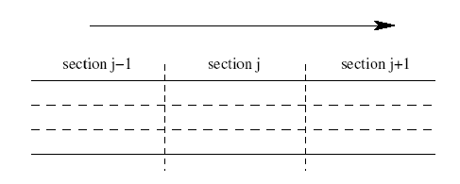
The Lighthill, Whitham and Richards (LWR) model
In practise the model is discretised in time and space (Daganzo: Cell-transmission model )
Discretization in time is done as considering time steps Δt
Discretization in space is done as dividing the motorway in sections Δx.
For numerical stability of solutions Δx > vΔt for all sections in network.

Slide 10

The Lighthill, Whitham and Richards (LWR) model
Discretisation of first equation in model with time steps Δt is:

Slide 11
Macroscopic models
Other model types:
  Payne (”2nd order”) such as METANET. Adds more terms to the diff. Eq. To capture ’pressure’ etc.
  Lagged Cell-transmission model (Daganzo)
  Gas-Kinetic type models (Herman & Prigogine, Helbing et. Al.)

Slide 12
Microscopic models
Describe the vehicles and vehicle interations in detail
Consist of a number of behavioural models:
  car-following model : describes the acceleration, deceleration and distance-keeping of vehicles
  lane-changing : describes the lane-change decisions: acceptable gaps, when to change
  yielding: describes the yielding behaviour at intersections, merging sections etc.
Types of car-following models:
  Stimulus-Response
  Psycho-spacing
  Safe distance

Slide 13
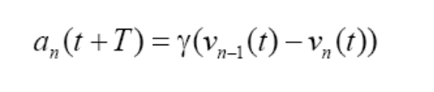
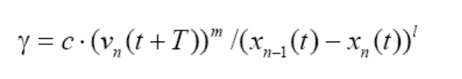
Micro models: stimulus-response
response = sensitivity x stimulus (Gazis et.al.)
Sensitivity:
Acceleration
sensitivity
Stimulus = difference in speed
Own speed
Distance to leader
Where
a_{n}(t) = acceleration at time t
V_{n}(t) = speed at time t
Xn(t) = position at time t
T = reaction time
γ = sensitivity
c, m, l = parameters

Slide 14
Micro models: stimulus response
Example: MITSIMLab
Problems:
  When difference in speed = 0, the acceleration = 0 even if the distance is very small
  When small fluctuations in speed-difference result in changing the acceleration : unrealistic that driver can perceive small changes
  Drivers are ’dragged along’ if the leader accelerates
Solutions:
  Different regimes: free-flow, approaching, following
  Different parameters for accelerating and decelerating behaviour

Slide 15
Micro models: Psycho-spacing
Perceptual psychology: limitations of perception
Basic rules:
  At large spacings, the following driver is not influenced by velocity differences.
  At small spacings, some combinations of relative velocities and distance headways do not yield a response of the following driver, because the relative motion is too small.
Examples: VISSIM (Wiedemann), AIMSUN/2

Slide 16
Mesoscopic models
Individual vehicles, aggregate behaviour on links.
Types:
  Queue-server at nodes, speed= F(density) on links
  Cellular automata: cell-hopping vehicles
  Packets of vehicles (CONTRAM)

Slide 17

Mesomodels: Cellular Automaton
http://rcswww.urz.tu-dresden.de/~helbing/RoadApplet/
1. Acceleration of free vehicles: IF (v < v_{max}) THEN v = v + 1
2. Slowing down due to other cars: IF (v > gap) THEN v = gap
3. Stochastic driver behavior: IF (v > 0) AND ( rand < p_{noise}) THEN v = v − 1
T₀
T₁
Notes:
Mesoscopic simulation has more detail than macroscopic models but less than the microscopic models
A common mescopic model type represents INDIVIDUAL vehicles but descibes their behaviour using aggregate rules.
In addition, some models (such as Contram) group vehicles into packets and move them using aggregate rules.
Another paradigm is Cellular automata:
The road is again discretised into small cells. Each cell is about the size of a standard vehicle (PCU). If there is a vehicle occupying this cell, it’s ’RED’, other wise Yellow. A simple set of rules determine how many cells a vehicle can ’hop’ in one time-step
EXAMPLES: DYNAMIT, DYNASMART, CONTRAM, MEZZO

Slide 18
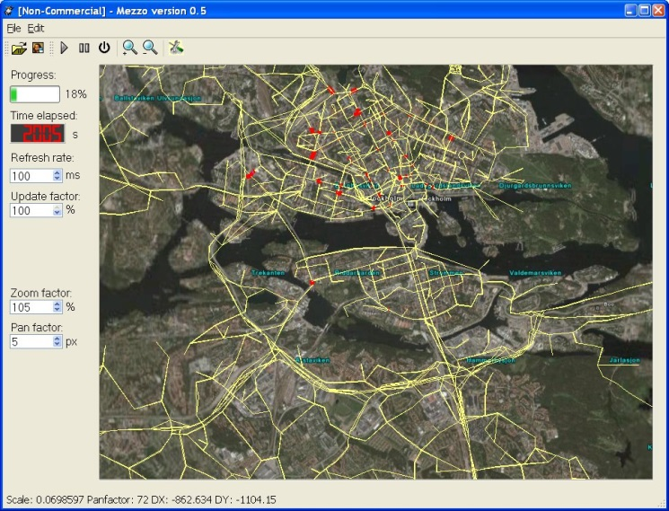
MEZZO: Event-Based Mesoscopic Model
Designed for integration with micro models
Vehicle-based, event-based
Links: Speed = f(density)
Nodes: Queue-servers for each turning
Queue formation and dissipation

Slide 19
MEZZO: Link Model
Running part
Queue Part
Running part contains all moving vehicles
Vehicle speed= f(density in running Part)
’expected exit time’
  t_{expected}= t_{current} + (link length / speed)
At any time t_{current} :
  All vehicles with t_{expected} < t_{current} are on the running part
  All vehicles with t_{expected} >= t_{current} are on the queue part
Only vehicles on the queue part can exit

Slide 20
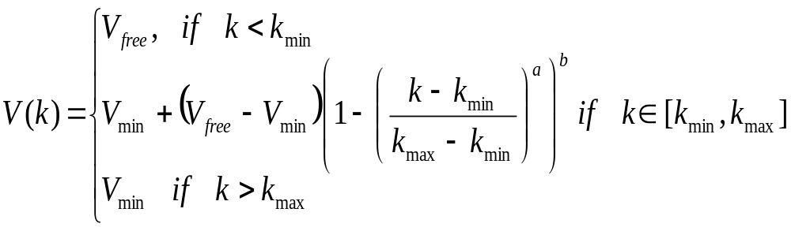
MEZZO: Speed = f(density)
Where:
  V(k) = speed assigned to the vehicle
  k = the current density on the running part of the link
  V_{min} = minimum speed
  V_{free} = free flow speed
  k_{min} = minimum density
  k_{max} = maximum density
  a, b = model parameters

Slide 21
MEZZO: Node model
Queue part contains all vehicles that should have left the link
Stochastic queue-server for each turning movement
Turning movements can block each other (look-back limit)
blocked
Running part
Queue Part

Slide 22
MEZZO: Shockwaves
Many meso models generally do not model start-up shockwaves
Essential in hybrid models for spilling over of queues at meso-micro boundaries
Solution: Update the exit times according to shockwave theory (LWR)
  Follow the queue front at start-up
  Calculate the new exit time for each vehicle
1
2
3
4

Slide 23
MEZZO: Route choice
Pre-trip choice with switching en-route
Historical travel times for pre-trip choice
Current (updated) travel times for en-route information & switching

Slide 24
Assignment in Mezzo
Loop 1
Shortest Path algorithm
Routes
New Routes
Travel Times
Network
Mezzo Simulation
New Travel times
Demand
Loop 2
Notes:
Route choice uses

